Slide 1

Reuse, Don’t Repeat
Creating an Infrastructure as Code Module Library

Slide 2







About Me
Sam Cogan
Solution Architect
samcogan.com
@samcogan
sam-cogan

Slide 3
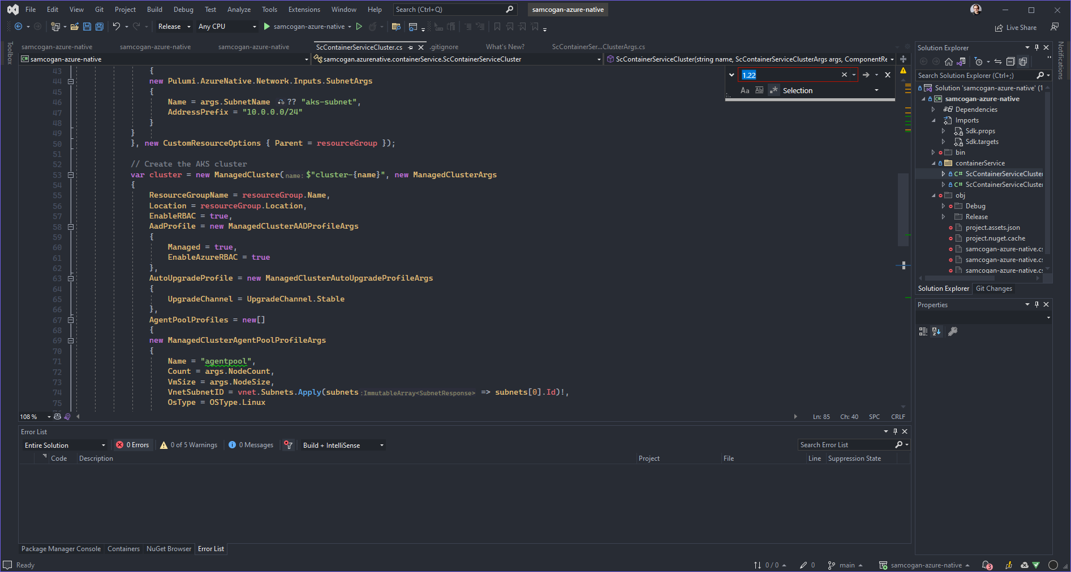
Reusable Infrastructure as Code

Slide 4
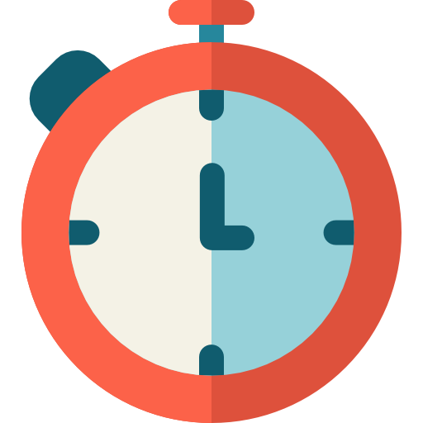
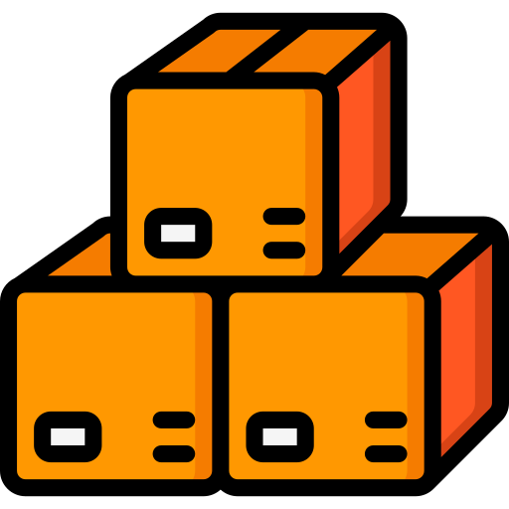
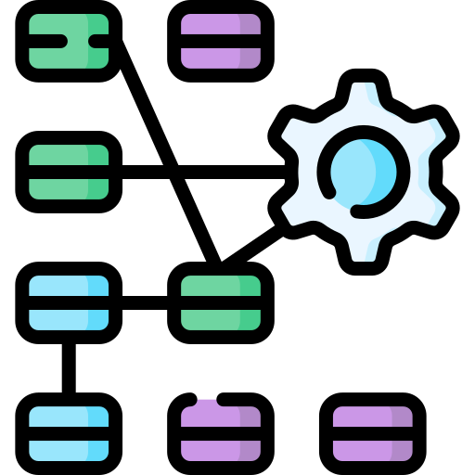


Why Create Reusable Modules?
Save Time
Promote Consistency
Hide Complexity
Apply Standards
Share Expertise

Slide 5





How do we Reuse?
ARM Templates – Nested Templates
Bicep – Modules
Cloud Formation – Modules
Pulumi – Component Resources/Packages
Terraform – Modules

Slide 6









Creating Good Modules
Do one thing and do it as simply as possible
Provide options, but not too many options
Add value, do more than wrap a resource
Version appropriately
Make them easy to obtain
Keep them updated
Start simple and evolve
Create great documentation
Evangelise and engage!

Slide 7
How do we Distribute Modules?
ARM Templates – Template Specs/Storage
Bicep – Template Specs/Storage
Cloud Formation – CF Registry
Pulumi – Nuget/NPM/PyPi
Terraform – Git/Terraform Registry

Slide 8
Demo Time

Slide 9




Real World Examples
Virtual Machines
Kubernetes Clusters
Network Layer
Configuration Module

Slide 10
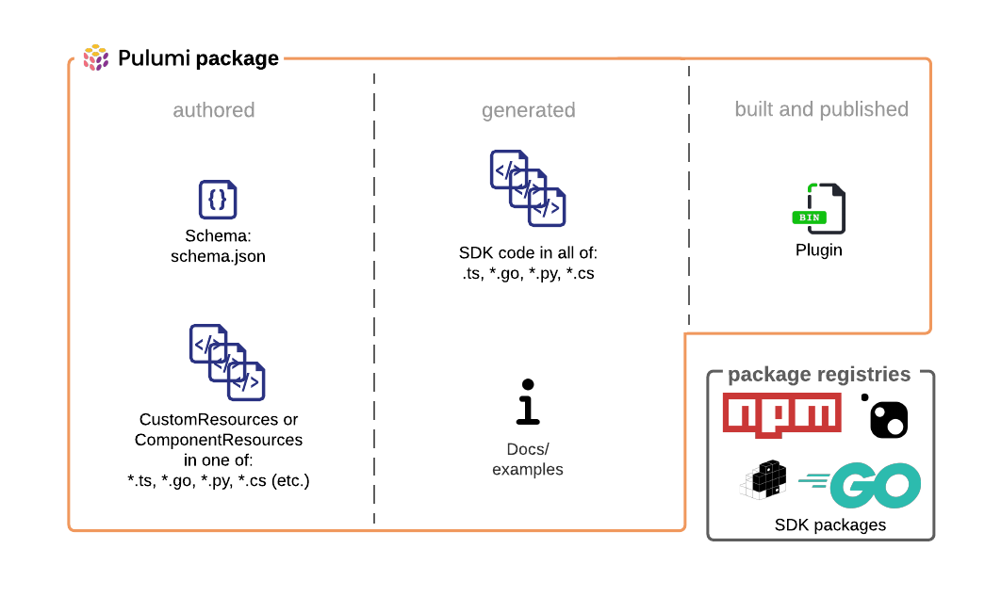
Pulumi Packages

Slide 11
About Me
Sam Cogan
Solution Architect
samcogan.com
@samcogan
sam-cogan

